Slide 1
E&P Update 11/16

Slide 2
Launch Box
Design Changes:
Old igniter with monster relay
Additional arming circuit for igniter
Finalizing details/components this week

Slide 3
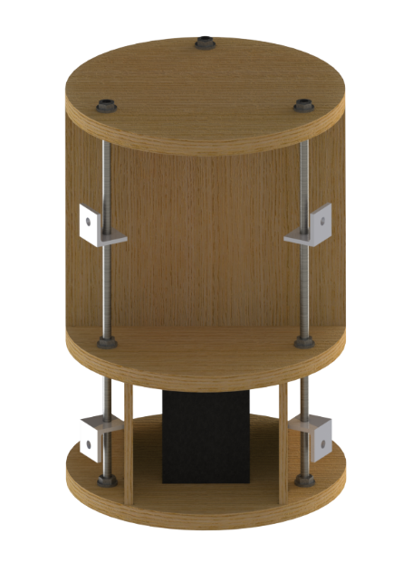
Avionics Tower
Brackets to attach to body tube okay with structures?

Slide 4
Wireless Transmission
Launch box xbee frequency changed to 2.4 GHz
Less crowded frequency
Shorter range, max 1 mile (need <1/2 mile for launch box)
No flight data transmission via xbee, stored on board
Will build or purchase point-to-point antennas
Vehicle tracking still at 430 MHz
Will construct or purchase yagi ground antenna

